Slide 1
Decidability
Are there languages not decidable by a TM? -- YES

Slide 2
Decider
A TM that halts on all inputs is called a decider. Note halts can be stop on q_{reject}
A decider that recognizes some language is also said to decide that language
A language is called Turing-decidable or simple decidable if some TM decides it.
Decide ≠ Recognize

Slide 3
Decide ≠ Recognizes
Decide ➔ stop
Recognize ➔ know what to do
Any regular language is Turing-decidable.
Any context-free language is Turing-decidable.
Every decidable language is Turing-recognizable (a language is Turing-recognizable if it is recognized by a TM).
Certain Turing-recognizable languages are not decidable (to be decidable means to be decided by a TM which halts on all inputs)

Slide 4
Recognizable vs. Decidable
A language is Recognizable iff there is a Turing Machine which will halt and accept only the strings in that language and for strings not in the language, the TM either rejects, or does not halt at all.
Note: there is no requirement that the Turing Machine should halt for strings not in the language.
A language is Decidable iff there is a Turing Machine which will accept strings in the language and reject strings not in the language, i.e., halt!!!

Slide 5
One decidable problem
Consider the acceptance problem for DFAs: test whether a particular finite automaton accepts a given string. This can be expressed as a language A_{DFA}
A_{DFA} contains the encodings of all DFAs together with strings the DFAs accept, i.e., A_{DFA} = {<B,w> | B is a DFA that accepts w}
To show that a computational problem is decidable is to show that the encoding of the problem is decidable.
A_{DFA} is a decidable language
Proved by construction
Similarly, A_{NFA} is a decidable language

Slide 6
CFL
The language we consider is:
A_{CFG} = {<G,w> | G is a CFG that generates string w}
A_{CFG} is a decidable language
Consider the language
E_{CFG} = {<G> | G is a CFG and L(G) = ∅}
Theorem 4.8: E_{CFG} is a decidable language
Even better, Theorem 4.8 saying “Every context-free language is decidable”

Slide 7
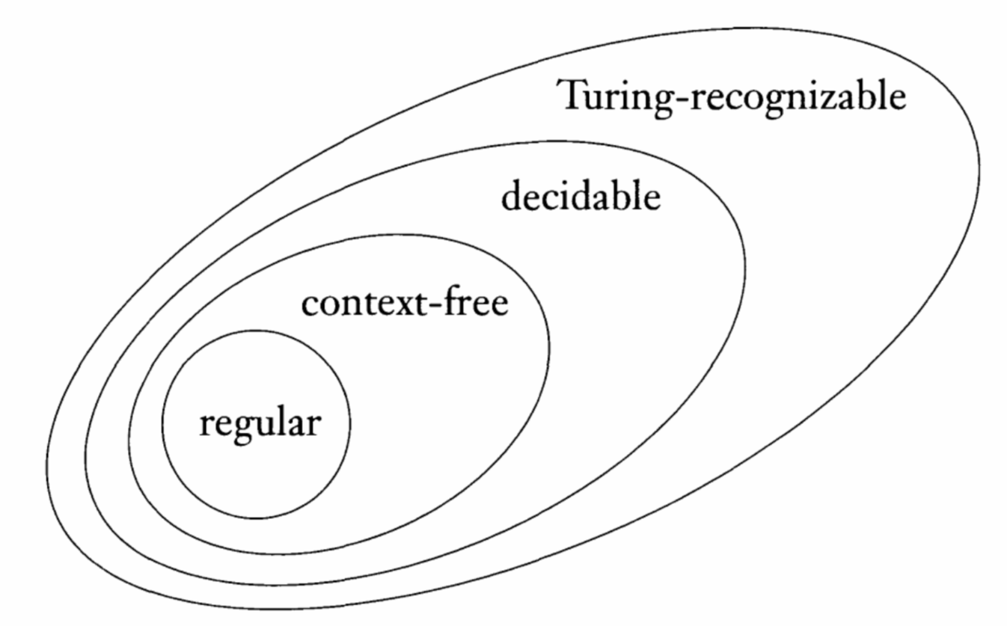
The relationship among class of languages

Slide 8
The Halting Problem of TM
It is also the membership problem of TM: whether a Turing machine accepts a given input string.
By analogy with A_{DFA} and A_{CFG} we call the corresponding language A_{TM}
A_{TM} = {<M, w> | M is a TM and M accepts w}
Contrasting A_{DFA} and A_{CFG}, which are decidable, A_{TM} is not decidable (Theorem 4.11)

Slide 9
A recognizer for A_{TM}
The following TM U recognizes A_{TM}
U = "On input <M,w>, where M is a TM and w is a string
1. Simulate M on input w
2. If M ever enters its accept state, accept; if M ever enters its reject state, reject".
Problem: if M has a loop, then U will be looping, so it does not DECIDE. Worse yet, we cannot tell /detect when M is looping

Slide 10
Moving toward proving
The proof of undecidability of the TM membership problem uses Georg Cantor (1873) technique called diagonalization.
Cantor’s tried to measure the size of infinite sets.
For example,
The set of strings over {0, 1} is an infinite set
The set N of natural numbers {1, 2, 3 … } is also an infinite set
The set E of all even natural numbers is also an infinite set
How can we compare them?

Slide 11
The Correspondence
Consider two sets, A and B and function f : A → B
f is one-to-one if it never maps two different elements of A into the same element of B, i.e., f(a) ≠ f(b) whenever a ≠ b.
f is onto if it hits every element of B, i.e., ∀b ∈ B, ∃a ∈ A such that f(a) = b
f is called a correspondence if it is both one-to-one and onto
N = {1, 2, 3, ... ...}, i.e., natural numbers
Two sets A and B have the same size if there is a correspondence f : A → B
Using this concept, if we define f : N → E as f(n) = 2n, then |N| = |E| . That is, E is countable.
A set is countable if it is either finite or has the same size as N (Definition 4.14).

Slide 12
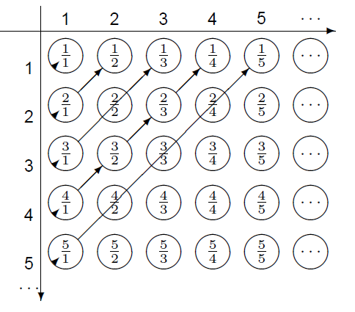
Try this one
Let Q be the set of positive ration-al numbers, Q = { | m, n ∈ N}
Yet we can show that this two sets have the same size by constructing the correspondence in Figure 4.16:

Slide 13
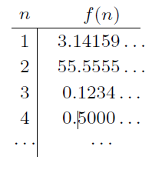
Show me an uncountable set then
The set R of real numbers is uncountable
Proof:
Assume a correspondence
f : N → R exits (shown at right)
Construct x be a number between 0 and 1, i.e., (0, 1) by the following procedure:
x = 0.d₁d₂d₃d₄ . . . has an infinite number of decimals constructed by the rule: ∀_{i} ∈ N chose d_{i} a digit different from the i-th digit of f(i)
Consequence: ∀_{i} ∈ N, x ≠ f(i). Hence, x does not belong to the list R and thus f is not a correspondence.

Slide 14
Other uncountable sets
The real numbers R₁ = (0, 1)
The powerset P(N)
The set of all formal languages L = {L | L ⊆ Σ* }
Some formal languages are not Turing-recognizable.

Slide 15
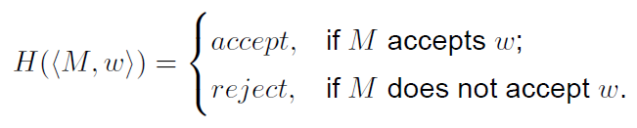
Halting Problem is Undecidable
A_{TM} = {<M, w> | M is a TM and M accepts w} is undecidable
Proof Idea: By contradiction, assuming that a TM is decidable.
Suppose that H is a decider of A_{TM}.
On input <M,w> where M is a TM and w is a string, H halts and accepts if M accepts w.
Also, H halts and rejects if M fails to accept w.
That is,

Slide 16
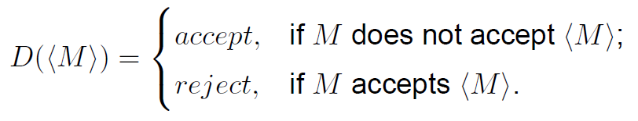
Turing Machine D
Construct a new TM D that uses H as a subroutine.
D calls H to determine what M does when its input w is M (represented as <m>)
if M accepts w then D rejects;
if M rejects w then D accepts;
Note that we take the machine as the input
D = "On input <M>, where M is a TM:
1. Run H on input <M, <M>>
2. Output the opposite of what H outputs:
accepts if H rejects and rejects if H accepts."

Slide 17
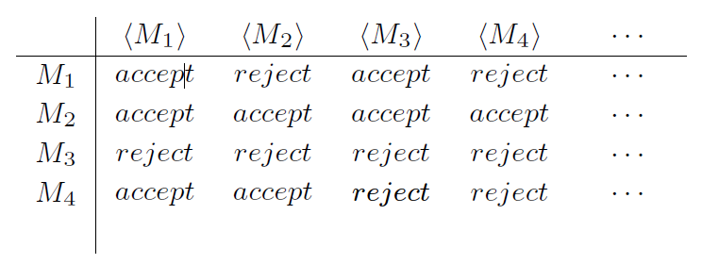
Running H – no problem

Slide 18
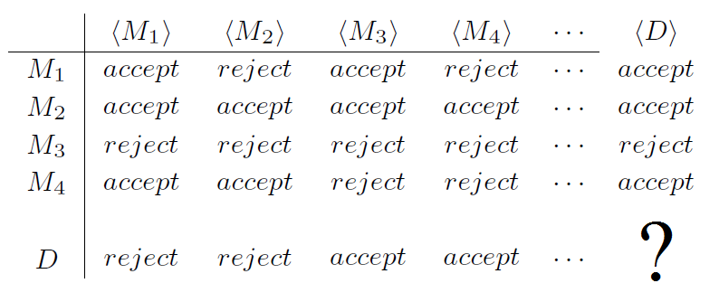
Try to carry out Machine D
Remember: D computes the opposite of the diagonal entries

Slide 19
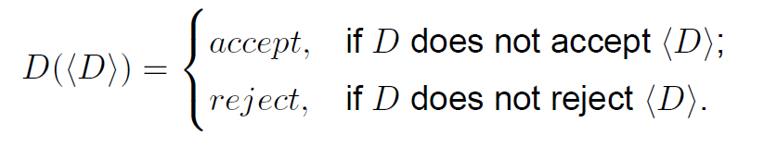
A CONTRADICTION
This is a contradiction and indicating neither TM D nor TM H exist.
That is, there is no algorithmical solution to Halting problem. TMs cannot be constructed to tell if an input will eventually stop or not on ALL inputs.

